Slide 1

December 26, 2022
STUDBUD
A digital solution to maintain your productivity!
Developer:
Raiyan Ashraf
Roll: 1907023
Dept of CSE, KUET.

Slide 2
Objectives
To create a java based project to implement programming to solve real life problems.
To implement knowledge acquired during all the sessional.
Creating an interactive UI designed by java framework such as java Swing or JavaFX
Use databases to manage our data, use of MySQL in such endeavour.
Dynamic use of database during program execution.
page 01

Slide 3
Introduction
StudBud is a multi-user productivity app based on JavaFx GUI interface and MySQL databases . It is designed mainly to help students as well as
other professionals to manage their studies, personal life as well as to keep a track of their life. In modern days, we spend more of our time behind the computer screen. That is why StudBud is here, a java based desktop application to assist the user to sharpen their productivity and management skills.
Key Technologies:
01
Language: JAVA
02
SDK: Java 15.0, Library: JavaFX 19 SDK, IDE: Intellij
03
Database: MySQL
page 02

Slide 4
WHY USE STUDBUD
Comfortable
Simplicity
Keep Track
The functionality and UI is designed completely for the convenience of users.
Use the app to keep track and get control of your life and works!!
It is really Simple to use.
page 03

Slide 5
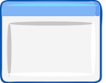



update
profile
taskDash
START
taskTimer
Add your idea here
login
Home
taskSelector
Add your idea here
register
widgets
stop/count watch
progress
Figure: Complete flow chart of the app
page 04

Slide 6
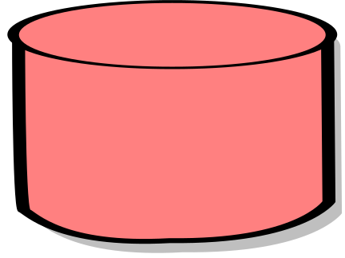

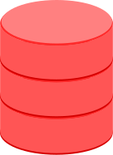
user4 Task table
user3 Task table
main users database
user2 Task table
user1 Task table
Figure: Basic Database Structure
page 05

Slide 7
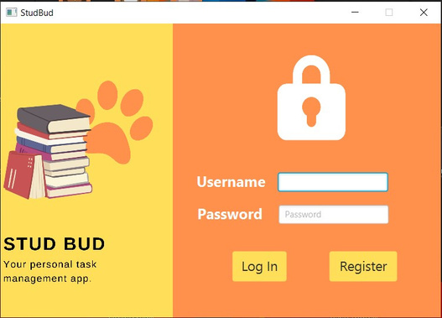
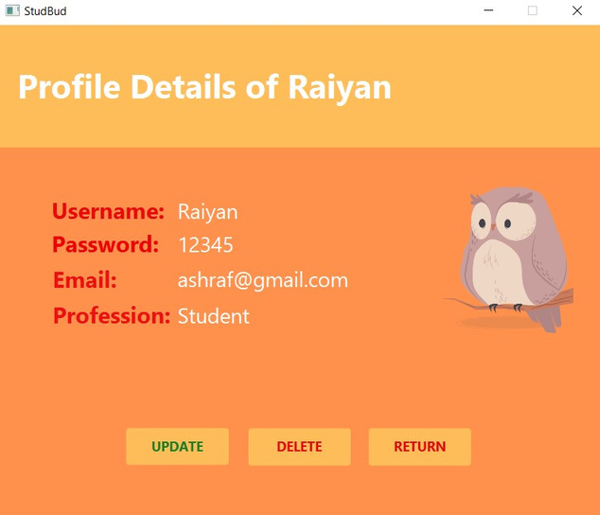
Explaination of Each Stage: Login Page
Take username and password as input. Connect to database and checks. If matches, then allows to proceed
Register page creates new user in the main userinfo table. Then returns to login
Add your idea here
page 06

Slide 8
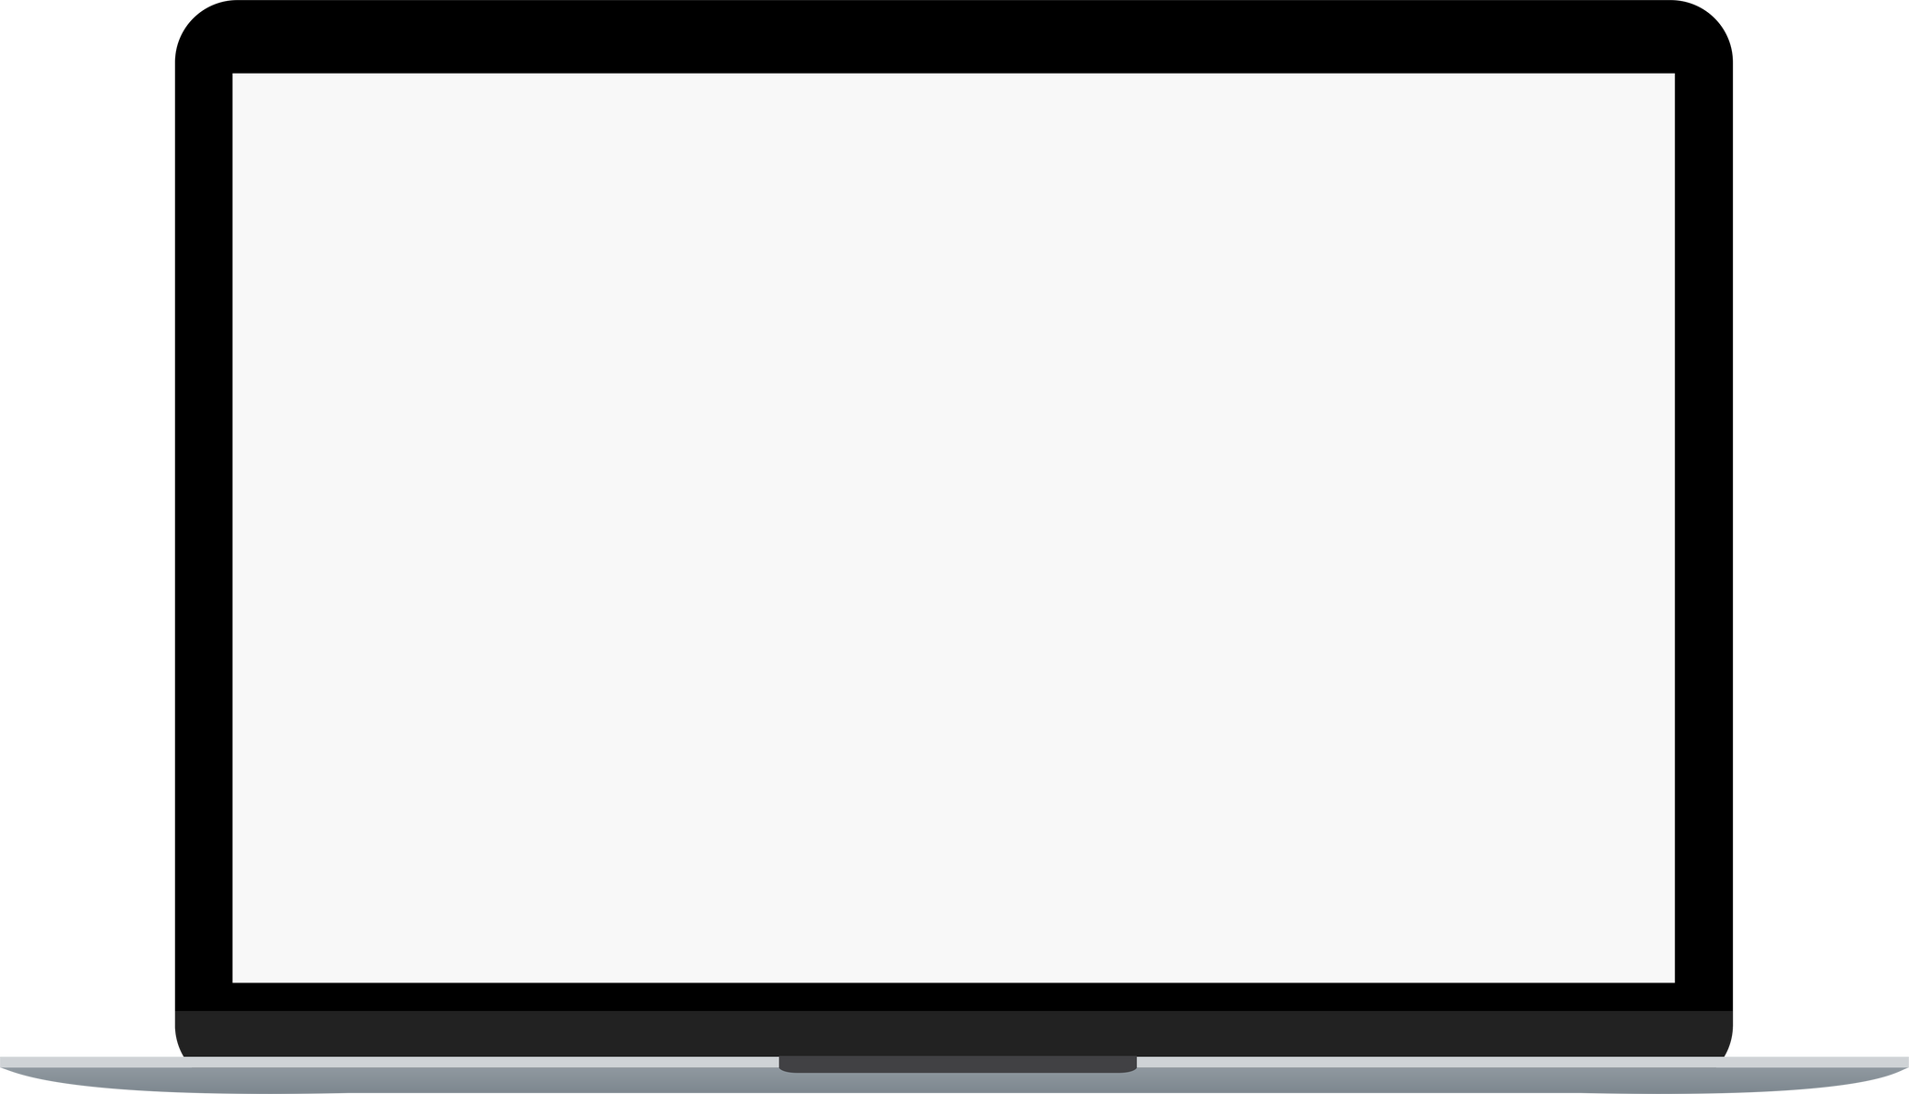
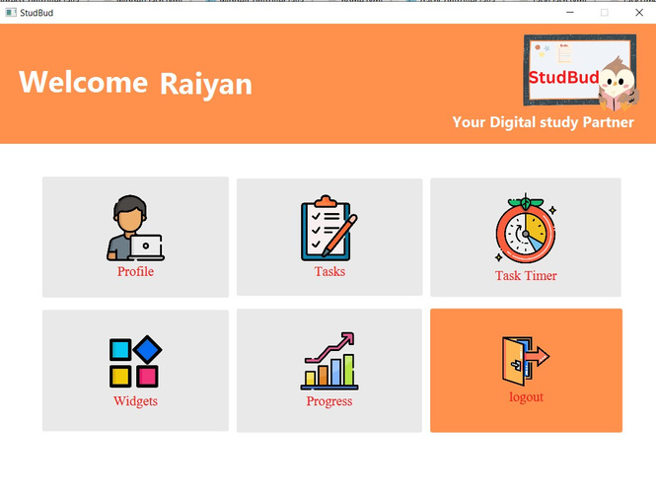
Main Home Page
It is our main home page. From here we will navigate towards different functionalities.
The functionalities are divided mainly into 5 parts.
If we Log Out from main page, it will take us to login again.
CSS was used to design this tab.
Add your idea here
page 07

Slide 9
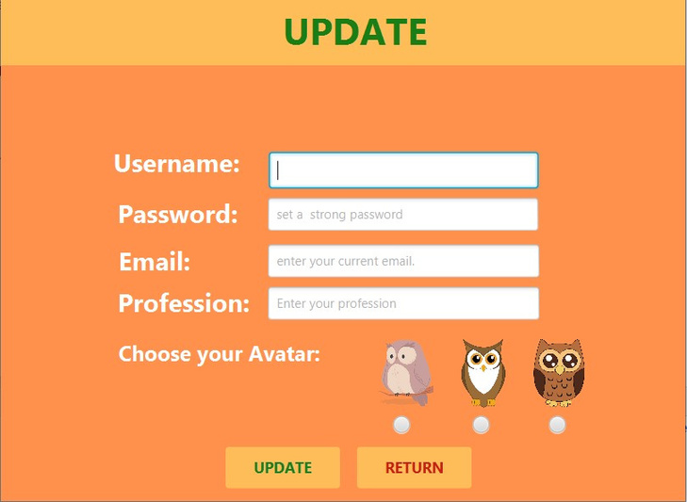
User Profile: Update, Delete functionalities.
This part mainly update the main user information or delete account. here in this case, we can update any particular leaving the rest. But update is not possible if all filed are empty.
Basic CRUD operations. Based on primary key (ID)
Add your idea here
page 08

Slide 10
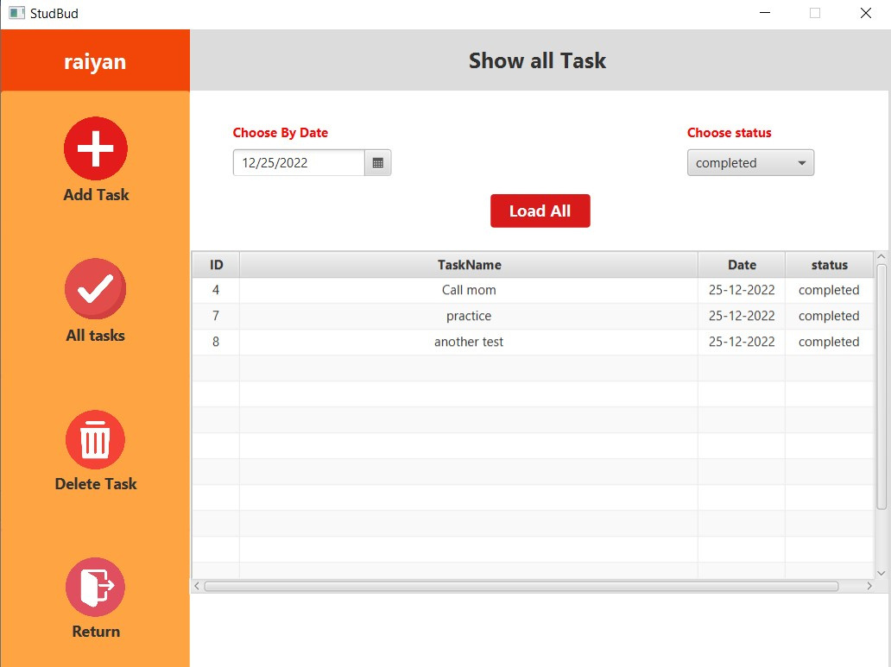
Task Dash Controller
Main task view.
Add task to tasktable dedicated to particular user.
select task and delete.
Filter out tasks based on dates or status.
Basic CRUD operation on the table dynamically created and named after the user.
Add your idea here
page 09

Slide 11
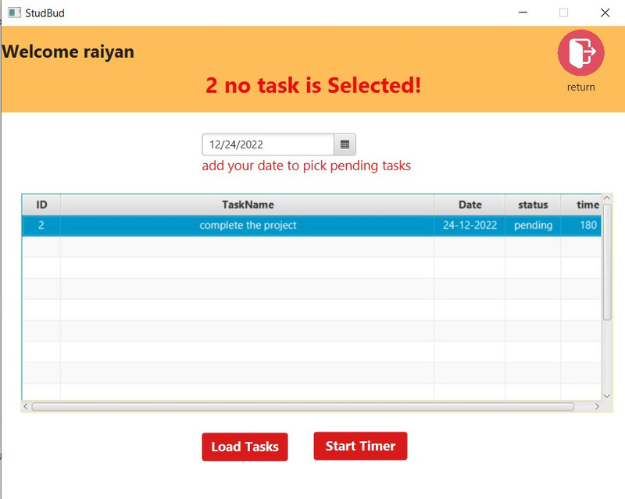
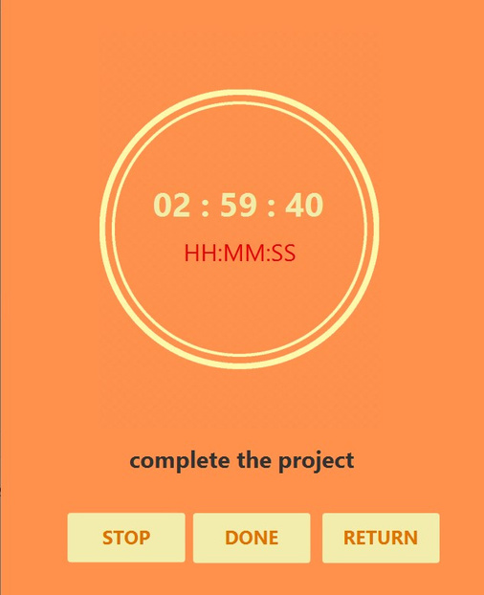
Task Timer: Selector and Timer
We can select the task from our task database.
Load pending tasks based on Time.
Select and start timer.
IF task is not completed within time, done button is disabled and task will remain incomplete.
If done, it will complete.
Add your idea here
page 10

Slide 12
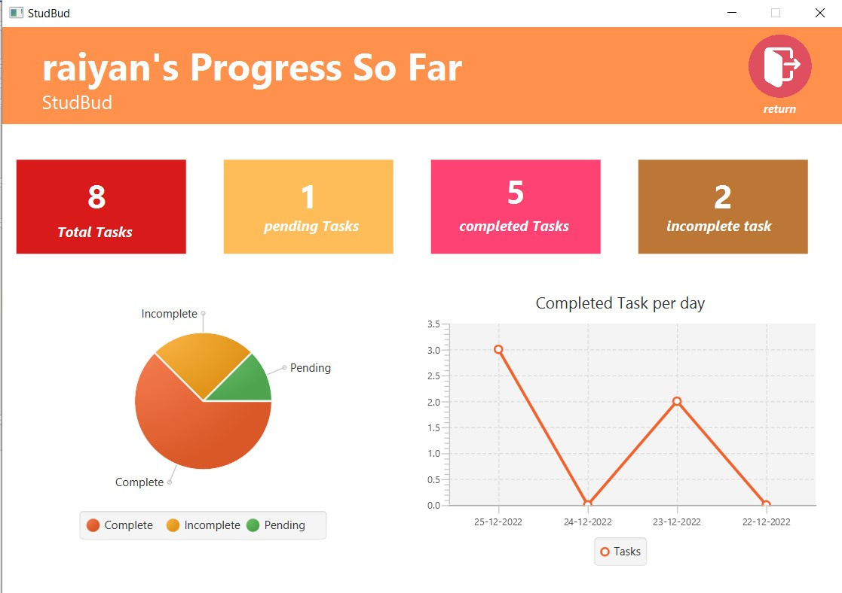
User Progress So far
Shows total number of completed, incomplete and pending tasks for that particular user.
The pie chart is the visual representation of that data
The line graph gives a graph based on completed task for last four days (from present day)
Helps the user to keep track.
Add your idea here
page 11

Slide 13
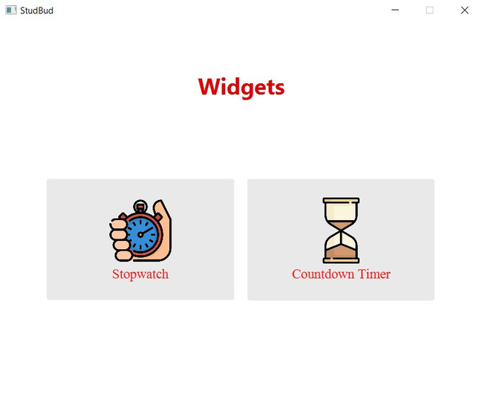
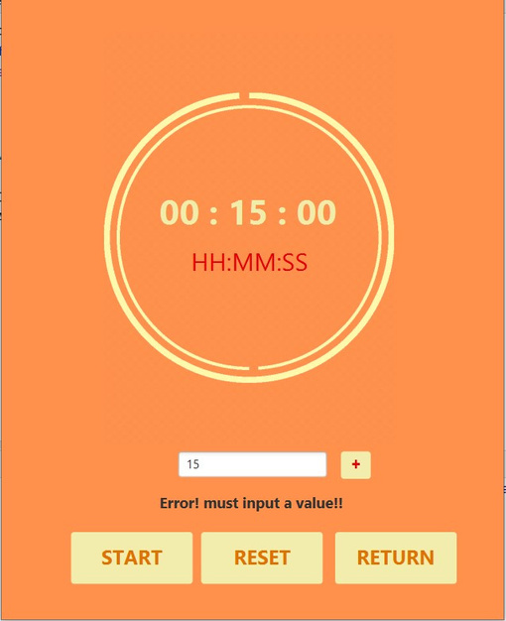
Task Timer: Selector and Timer
Some widgets are added here for the user.
Currently there are two, Countdown timer and Stopwatch.
The user can download more cool widget to use in the app in further update.
Add your idea here
page 12

Slide 14
That's all!
Thank you

